Slide 1

Multi-version Concurrency Control Database System
COMP90020 Distributed Algorithms Project
Group 4

Slide 2
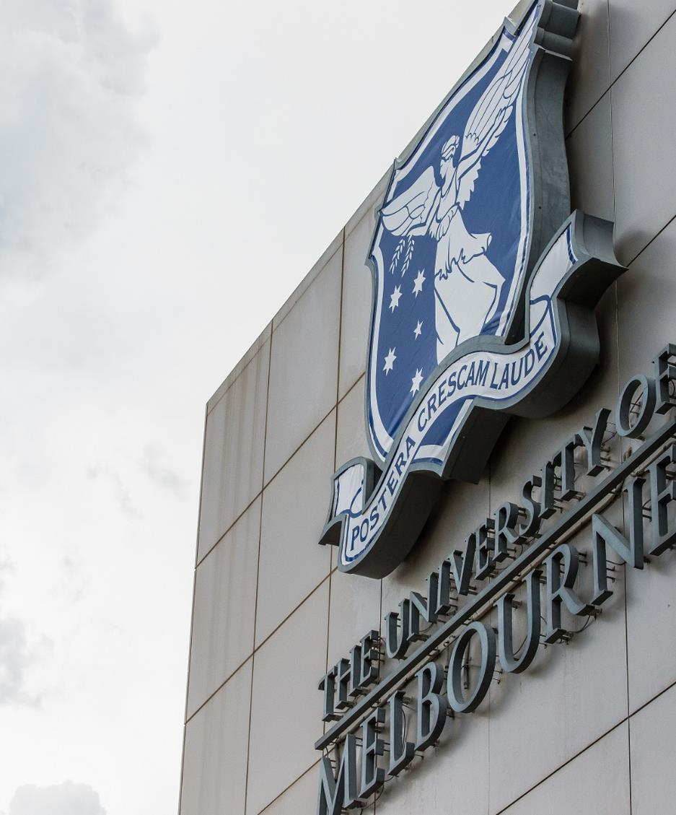
Overview
Multi-version Concurrency Control Algorithm
Application Demo – MVCC Database System
Implementation Challenges and Solutions

Slide 3
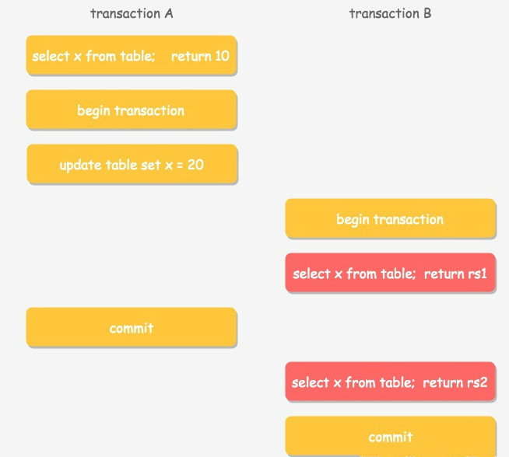
Multi-Version Concurrency Control
Goal:
Serialize concurrently executed transactions by managing multiple versions of each data item to avoid undesirable results ( i.e. ‘Lost Update’, ‘Dirty Read’, ‘Inconsistent data Retrieve’).
Solve Read/Write conflicts without using lock.
Achievements:
Version Control Algorithm Implementation.
Concurrency Control Algorithm Implementation.

Slide 4
Application Demo – MVCC Database System
Database Demo:
Client + Server structure
Database server take care of clients concurrent transaction requests.
Transaction Operations:
Select/Insert/Delete/Update/Commit/Rollback/Timeout control
Timestamping transactions and data items
Data Backup + Client Crash Simulation
Graphical Interaction Interface
Multi-version concurrency control Algorithm plays a key role at ensuring the correct execution of the concurrent transaction operations.

Slide 5
Implementation Challenges
Version Control Algorithm:
Track and record data items’ versions.
Periodical garbage collection of old version records.
Concurrency Control Algorithm:
Read/Write conflicts.
Transaction aborts and rollback.
Serialize transaction operations by timestamp.

Slide 6

Group 4：
Xinnan SHEN 1051380
Xiguang Li 944558
Chaoxian Zhou 1096367
Huidu Lu 717910

